Slide 1
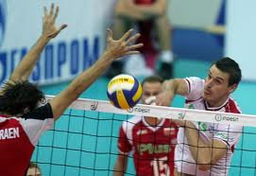
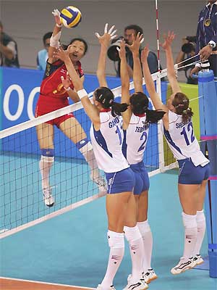
Volleyball

Slide 2
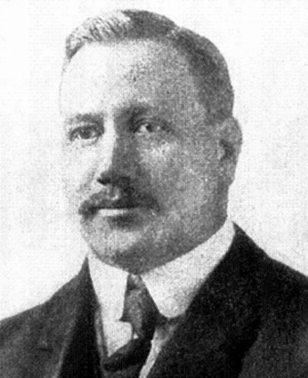
History
William G. Morgan is a YMCA, Physical Education Director
Founded in Holyoke, Massachusetts
The game was first created on February 9, 1895
He took characteristics from tennis and handball to create Volleyball.

Slide 3
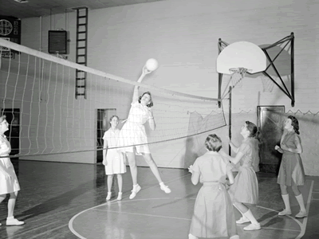
First set of rules and play
The first rules, written down by William G Morgan, called for a net 6 ft 6 in (1.98 m) high, a 25×50 ft (7.6×15.2 m) court, and any number of players.
A match was composed of nine innings with three serves for each team in each inning, and no limit to the number of ball contacts for each team before sending the ball to the opponents’ court.
In case of a serving error, a second try was allowed.

Slide 4
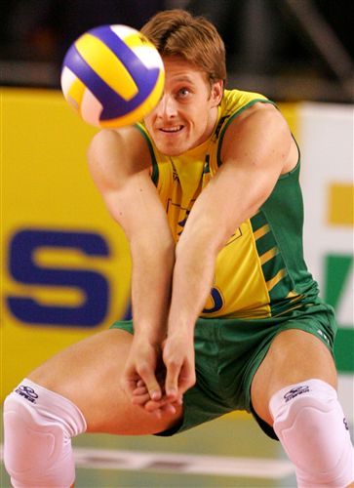
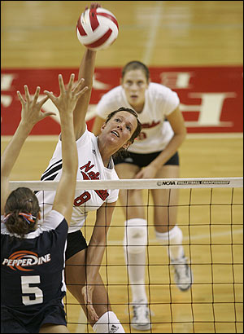
Bump – Set - Spike

Slide 5
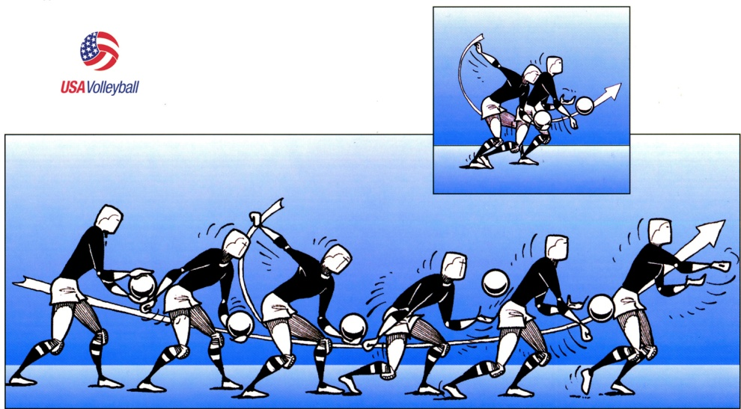
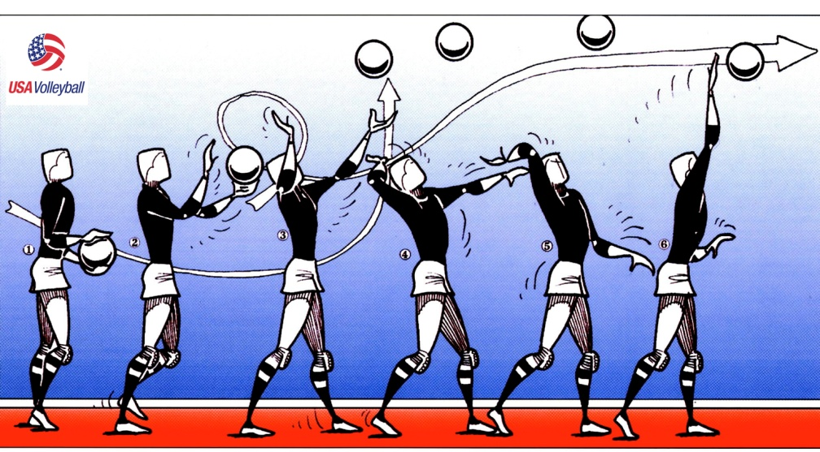
Serving:
Server must serve from behind the restraining line ( end line ) until after contact.
Ball may be served underhand or overhand.
Ball must be clearly visible to opponents before serve.
Served ball may graze the net and drop to the other side for point.
First game serve is determined by a volley, each subsequent game shall be served by the previous game loser.
Serve can be returned by a bump or a set. No attacking a serve.

Slide 6
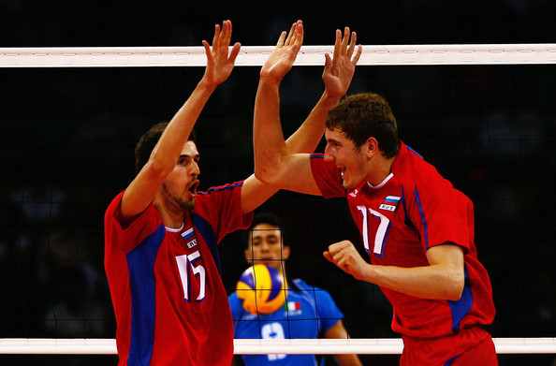
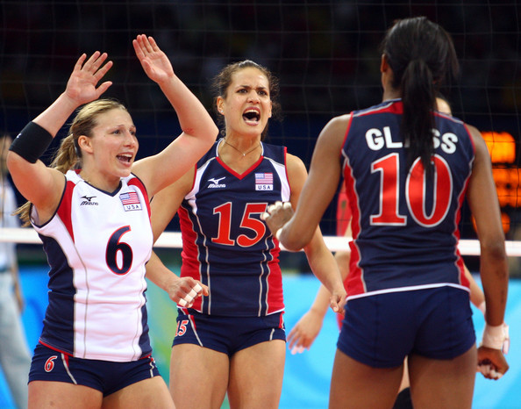
SCORING:
Rally scoring will be used.
There will be a point scored on every score of the ball.
Offense will score on a defense miss or out of bounds hit.
Defense will score on an offensive miss, out of bounds hit, or serve into the net.
Game will be played to 25 pts.
Must win by 2 points.

Slide 7
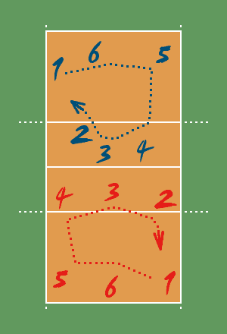
Rotation:
Team will rotate each time they win the serve.
Players shall rotate in a clockwise manner.
There shall be 6 players on each side.

Slide 8
Playing the Game (Volley)
Maximum of three hits per side.
Player may not hit the ball twice in succession ( A block is not considered a hit ).
Ball may be played off the net during a volley and on serve.
A ball touching a boundary line is good.
If two or more players contact the ball simultaneously, it is considered one play and the players involved may not participate in the next play.
A player must not block or attack a serve.
Switching positions will be allowed only between front line players. ( After the serve only ).

Slide 9
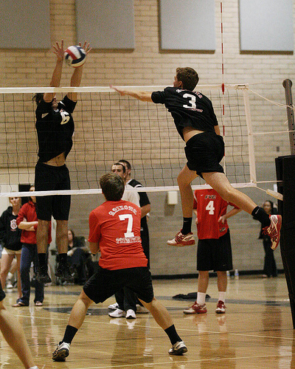
VIOLATIONS:
Stepping on or over the line on a serve or center line.
Failure to serve the ball over the net successfully.
Hitting the ball illegally
(Carrying, Palming, Throwing, etc. ).
Touches of the net with any part of the body while the ball is in play. If the ball is driven into the net with such force that it causes the net to contact an opposing player, no foul will be called, and the ball shall continue to be in play.

Slide 10
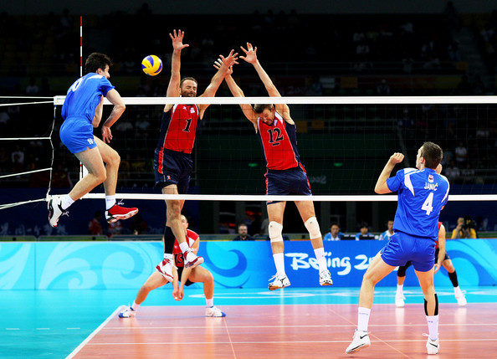
VIOLATIONS:
Reaching over the net, except under these conditions:
1 - When executing a follow-through.
2 - When blocking a ball which is in the opponents court but is being returned ( the blocker must not contact the ball until after the opponent who is attempting to return the ball makes contact). Except to block the third play.
Reaches under the net ( if it interferes with the ball or opposing player ).
Failure to serve in the correct order.
Blocks or spikes from a position which is clearly not behind the 10-foot line while in a back row position.

Slide 11
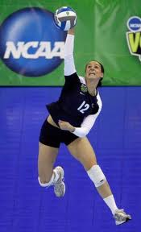
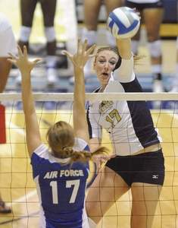
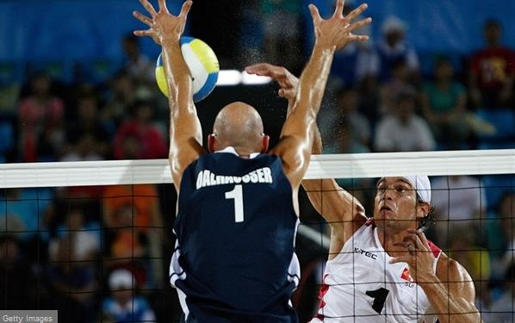
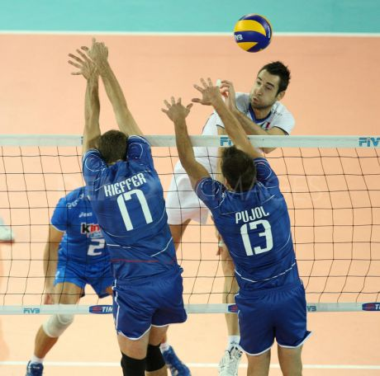

Slide 12
TERMS:
Ace- When the ball is served to the other team, and no one touches it.
Dig- When a player makes a save from a very difficult spike.
Kill- When a team spikes the ball and it either ends in a point or a sideout.
Roof- When a player jumps above the height of the net, and blocks the ball.
Sideout- When the team that served the ball makes a mistake, causing the ball to go to the other team.
Stuff- When a player jumps about the height of the net, blocks the ball, and the ball goes back at the person who attacked(spiked) the ball.

Slide 13
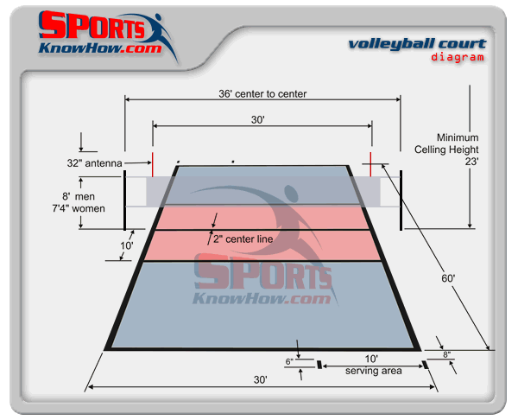
Court Size
Height of the Net?

Slide 14
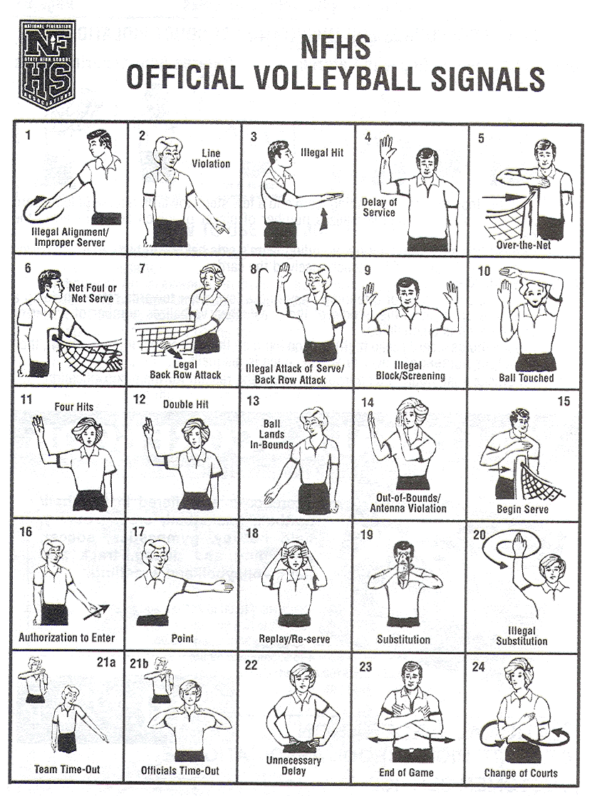
Referee Signals

Slide 15
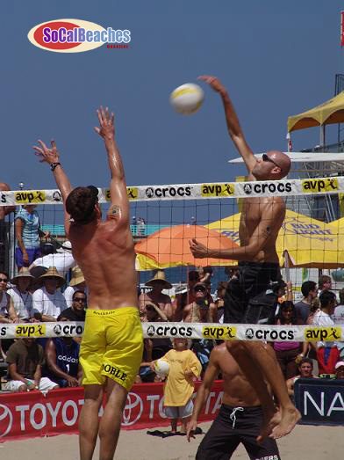
Today
Fastest growing sport in the West Coast. Olympic Sport since 1964. Today we have Sand Volleyball. Both males & females are played at the Olympics since 1996 (two person).

