Slide 1
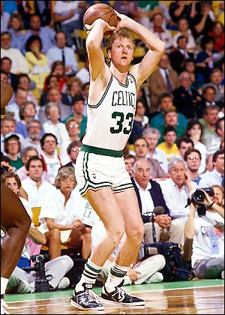
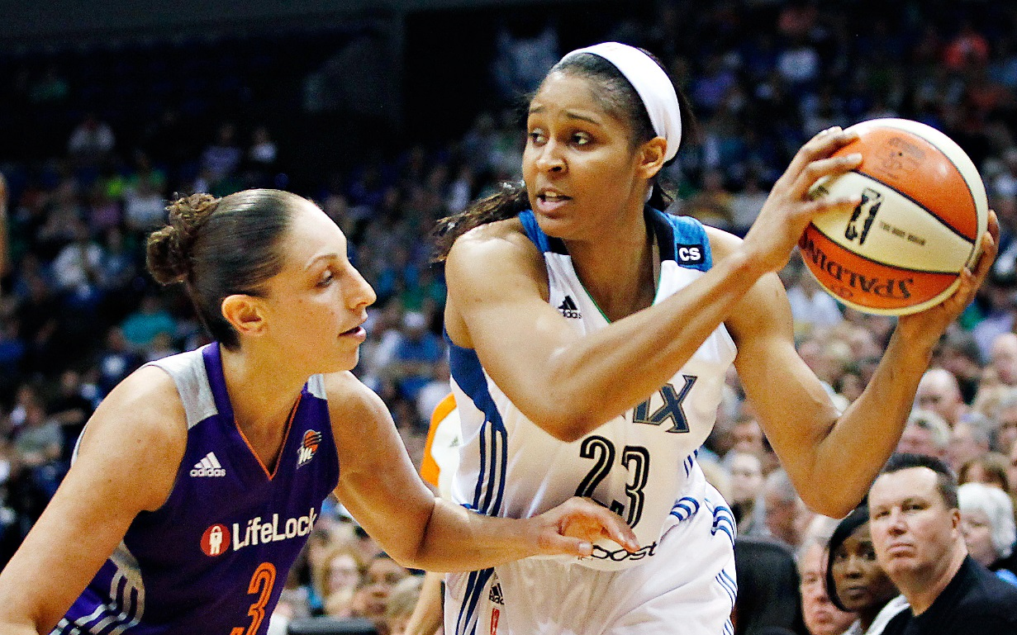
Basketball

Slide 2
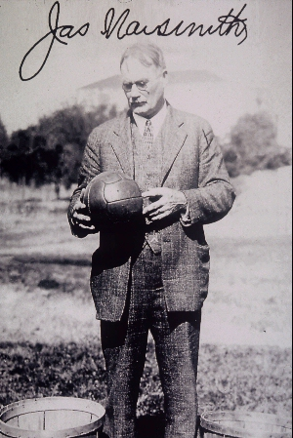
History
Dr. James Naismith is known world-wide as the inventor of basketball.
He was born in 1861 in Ramsay township, near Almonte, Ontario, Canada.
The first game was played in 1891 with a soccer ball and two peach baskets used as goals.
He died in Lawrence, Kansas, in 1939.

Slide 3
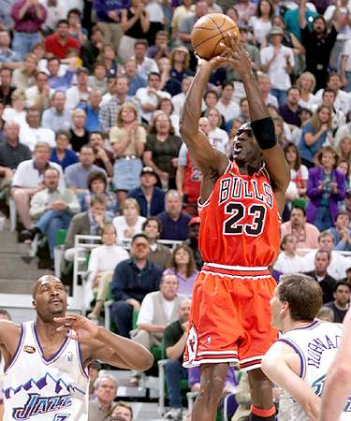
SCORING:
2 point field goal- a shot made from anywhere during play inside the 3 pt arc.
3 point field goal- a shot made from anywhere outside the 3 pt arc.
Free throw- 1 point is awarded to an unguarded shot taken from behind the free throw line while the clock is stopped.

Slide 4
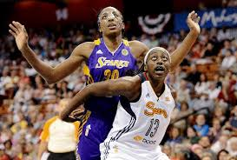
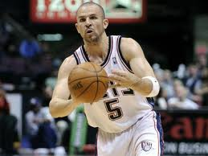
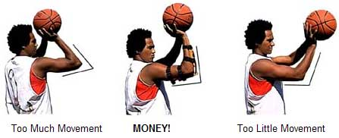
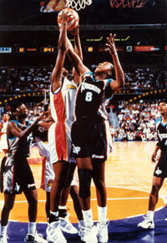
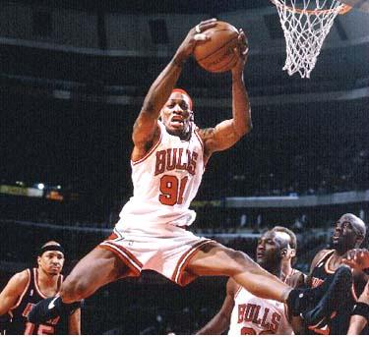
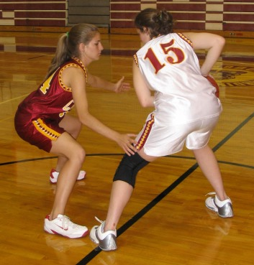

Slide 5
SKILLS:
Boxing out- a player’s position between an opposing player and the basket to obtain a better rebounding position.
Dribbling- bouncing the ball with 1 hand using your fingertips instead of your palm so that it rebounds back to yourself (the only legal way to move with the ball)
Passing- moving the ball by throwing, bouncing, handing, or rolling it to another player (Chest, Bounce, Lob)
Shooting- throwing the ball to make a basket
Pivoting- stepping once or more in any direction with the same foot while holding the other foot at its initial point.
Rebounding- The recovering of a shot that bounces off the backboard or the rim.

Slide 6
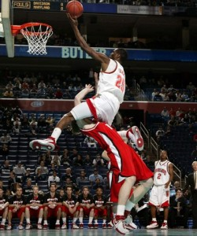
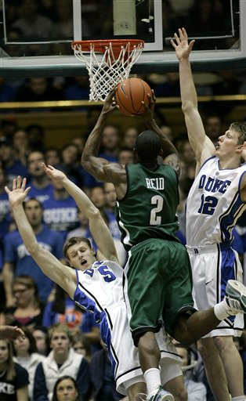
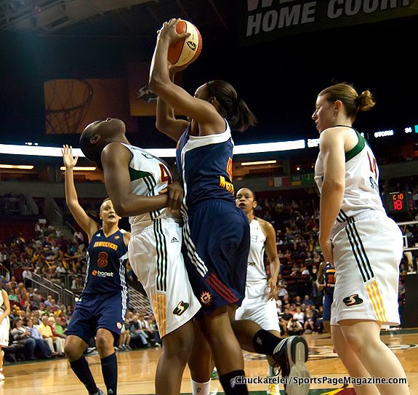
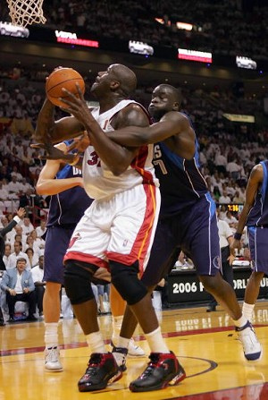
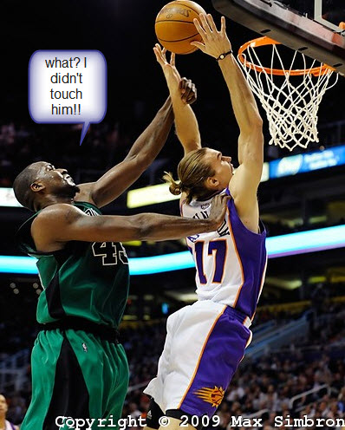

Slide 7
FOULS: results in one or more free throws awarded to the opposing team
Blocking- impeding the progress of an opponent by extending one or both arms horizontally or getting in the path of a moving player.
Charging- running into a stationary player while you are moving with the ball.
Hacking- the player hits the arm or hand of the person holding the ball.
Holding- the player holds the person with or without the ball.

Slide 8
VIOLATIONS: results in a change of possession with the team in bounding the ball at the side line opposite where the infringement took place
Traveling- moving illegally with the ball
Three seconds- an offensive player remains in the key (free throw lane- the area under the basket) for more than 3 seconds
Double dribble- a player dribbles the ball with both hands at the same time or they stop and then start dribbling again

Slide 9
TERMS:
Air ball- a shot that completely misses the rim and the backboard
Assist- a pass to a teammate who then scores a field goal.
Dunk- to throw the ball down into the basket with the hand above the level of the rim
Fast break- dribbling or passing the ball towards your basket before the defense can set up
Offense- team trying to score
Turn over- any loss of the ball without a shot being taken
Defense- team trying to stop the other team from scoring
Man-to-man- a defensive strategy where everyone guards an assigned player
Zone defense- a defensive strategy where everyone guards an area instead of a player (2-1-2, 2-3)

Slide 10
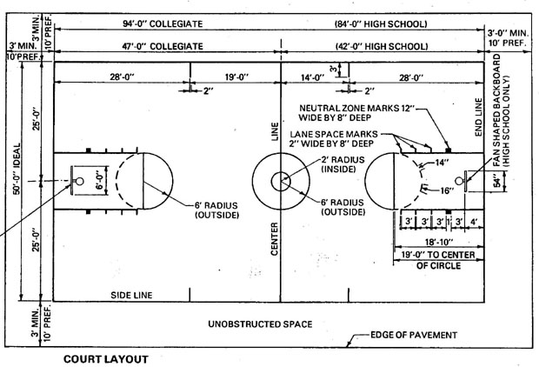
Court Size

Slide 11
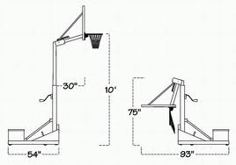
Height of the Rim?

Slide 12
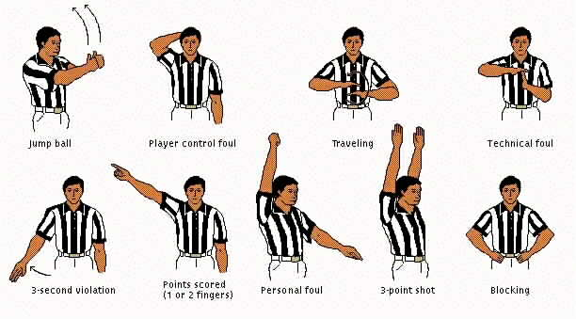
Referee Signals

Slide 13
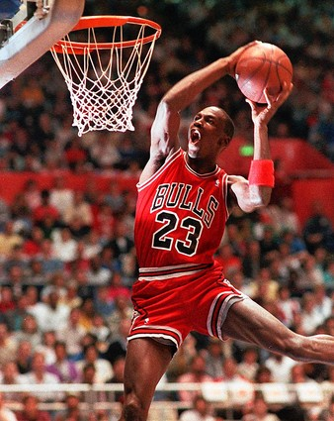
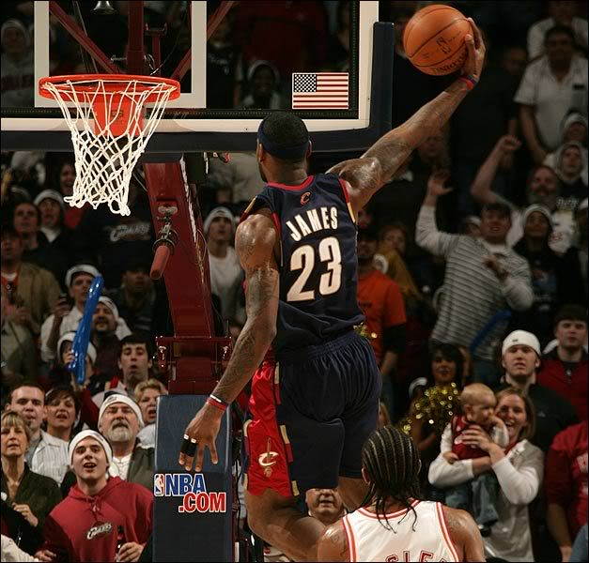
Today
Today basketball has grown to become one of the world's most popular sports.

