Slide 1
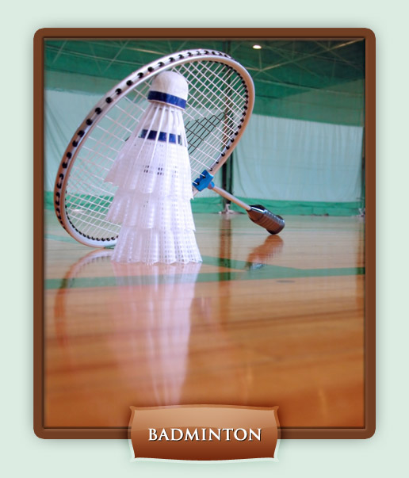
Badminton

Slide 2
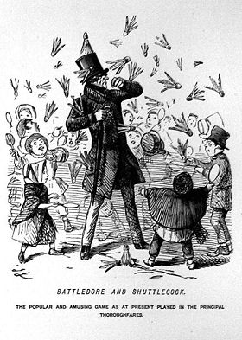
History
What is Battledore?
Thousands of years ago, a game called "battledore and shuttlecock" was popular in Greece, India, and China. This game was comprised of a shuttlecock that was batted back and forth by multiple players.
No net was involved, and the object of the game was to keep up the volley as long as possible.
Originally a child's game, battledore and shuttlecock evolved into a competitive sport.
The game caught on with British soldiers stationed in the area in the 1860-1870s, and they carried it back to their home country.

Slide 3
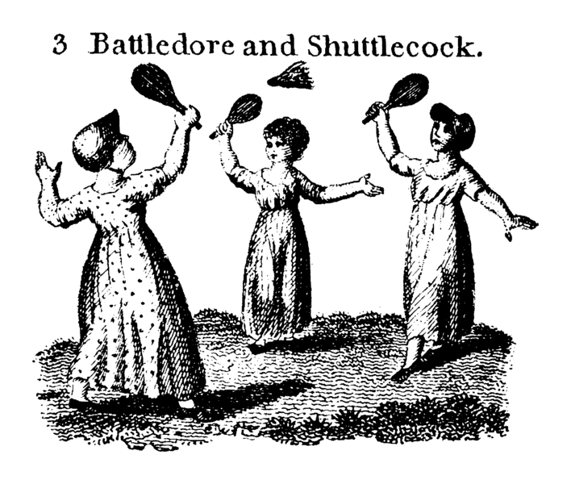
History
In 1873, the Duke of Beaufort officially introduced this new fad to England at a party on his estate. The estate, located in Gloucestershire, was called Badminton, which is how the name became associated with the sport.
Badminton continued its rise in popularity through the rest of the century and the beginning of the next.
In 1934, the International Badminton Federation was formed with nine countries included in its membership.
1948 saw the first official IBF tournament, and since then multiple world cups and events have taken place.
Badminton made its Olympic debut in 1992 at the Barcelona games.
Badminton is an extremely competitive sport in many countries and is becoming more and more popular all over the world. It's considered one of the favorite backyard sports of all time.

Slide 4
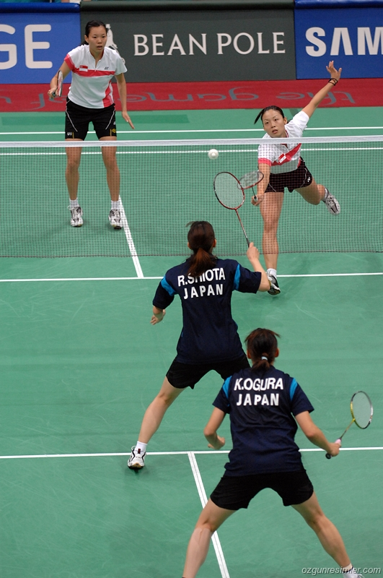
Rules & Regulations:
A badminton match is played to the best of three games.
A coin toss or spinning of the racket determines first serve or choice of side.
The object of a badminton game is to hit the badminton shuttlecock over the badminton net and onto the ground within bounds on your opponent's side of the court.
A rally can also be lost by hitting the shuttle into the badminton net, out of bounds, before it crosses the net to your side, or if it strikes your clothing or body rather than your badminton racket.

Slide 5
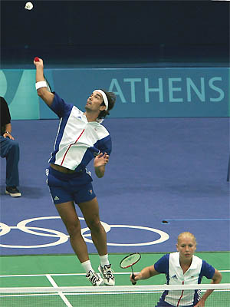
Scoring Formats
The modern badminton rules permit two different scoring formats:
1) service
2) rally.
In service play, a badminton game is won by scoring 15 points in doubles and men's singles, or 11 points in women's singles.
In rally play, 21 points are needed to win a badminton game.

Slide 6
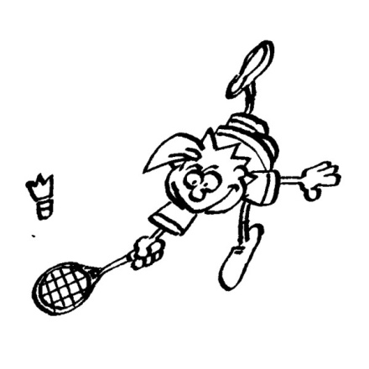
Service vs. Rally:
Service:
only the serving team may score a point. If the rally is lost, service passes to the opponent in singles play. In doubles play, except for the first service of a game, each player on a team is permitted to serve at least once before service is lost.
Rally:
a point can be awarded to either team, and in most cases, a point is awarded along with resumption of service, except when a rally point is lost by the first member of a serving doubles team.

Slide 7
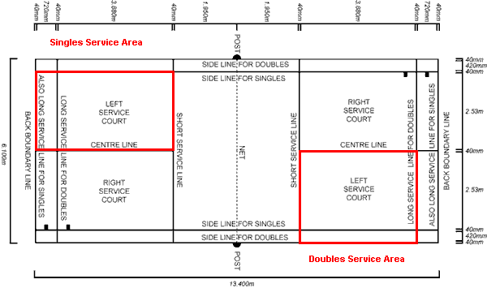
Serving Rules:
As in tennis, badminton
service is always done
diagonally, e.g. from the
right service court to the
opponent's left service
court. The first serve is
always taken from the
right court, and subsequent
serves are taken from alternating sides.
Line shots in badminton service or rallies are considered in, though court bounds are different for singles and doubles play. The back line is the same for both, but singles badminton is played with the narrower of the two sidelines.
A serve that strikes the net and lands in the opponent's court is a let serve and is retaken.

Slide 8
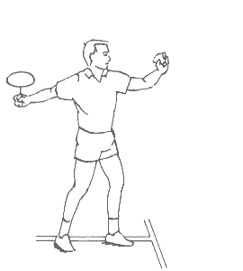
Serving Rules:
During service, players must stand in their respective service courts.
The receiving player is not permitted to move his/her feet until the badminton shuttlecock has been struck.
The highest part of the serving player's badminton racquet must remain below his/her hand and waistline during service. In other words, only underhanded serves are permitted.

Slide 9
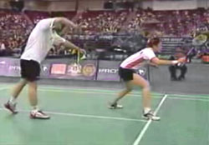
How to keep score
Serving in a doubles match basically boils down to the following:
There is no more just serving right: the side which wins a rally will get a point no matter they are serving or not. The side who wins will serve the next point.
Do I serve from the left or the right? This depends on the score of the serving party. If the score is zero or even, the team will serve from the right. If the score is odd, the team will serve from the left.
Should you and your partner switch service court (left to right, right to left)? The answer is NO
Therefore, when your side is not serving, don’t switch side. When you lose a point, don’t switch side. When the other side serves and you win this point, don’t switch side.

Slide 10
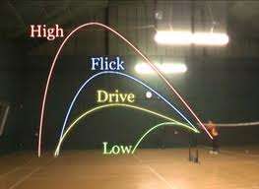
Type of serves:
High – drive your opponent back
Flick & Drive – A low, hard shot that travels horizontally without arc. It is used for a quick start
Low – bring in opponent for set-up

Slide 11
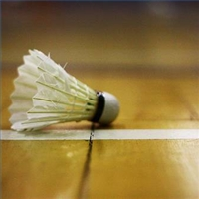
Violations are called faults
Fault: A violation of game rules, including but not limited to:
A serve that does not land in the service area.
A shot that lands outside the boundaries.
A player (or doubles partners) hitting the badminton shuttlecock twice before it goes over the badminton net.
A birdie that touches the ground before it is returned.

Slide 12
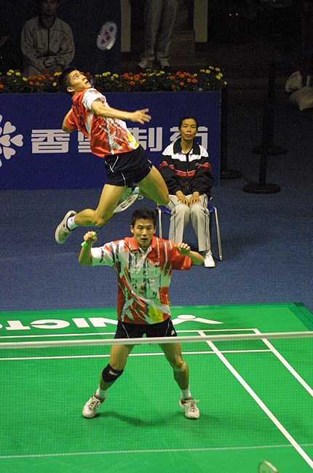
TERMS:
Bird or Birdie: A common name for the badminton shuttlecock.
Drop shot: A soft shot which arcs just over the net and drops to
the ground.
Let: An official break in play, caused by a minor violation such as
the shuttlecock touching the badminton net.
After a let, the rally is replayed and scores remain unchanged.
Rally: An exchange of shots leading to a point or service change.
Shuttlecock: A circular piece of rubber or cork that measures one to 11/8 inches in diameter. Attached to the base is a crown of 14 to 16 feathers, often made of plastic, which keep the badminton shuttlecock aloft when hit.
Smash: The most potent of all badminton shots. There is almost no defense against a well executed smash. It is an over the head swing.
Wood shot: A shot in which the badminton shuttlecock is hit by the frame of the racket instead of the strings. This shot was formerly illegal but was allowed into the game in 1963.

Slide 13
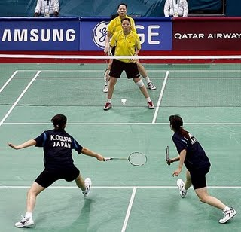
Double court positions
Side by side:
A doubles formation in which each partner is responsible for one side of the court.
Tandem (front & back)
A doubles formation win which each partner is responsible for the front or the back

Slide 14
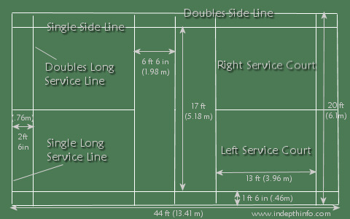
Court Size: (44 x 20)

Slide 15
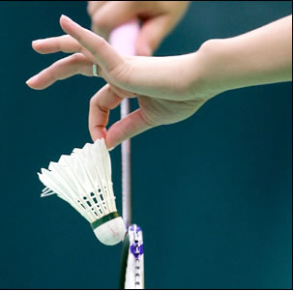
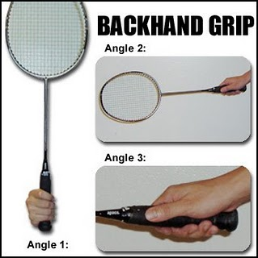
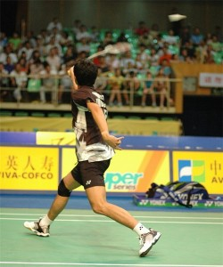
Basic badminton tools:
The toughest shot in badminton is
the backhand clear. More videos
Click on badminton tools above to watch 6 videos

Slide 16
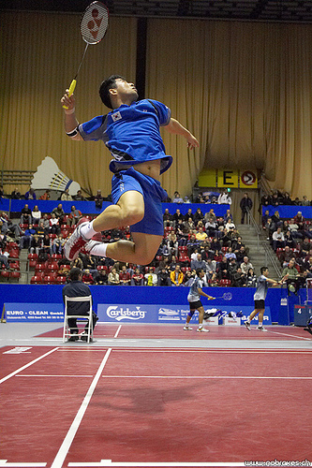
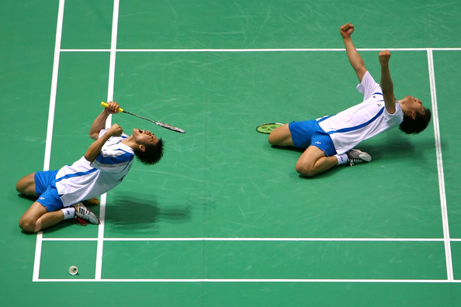
Badminton IS a SERIOUS game!!!
Click here to watch a serious doubles match

